Slide 1
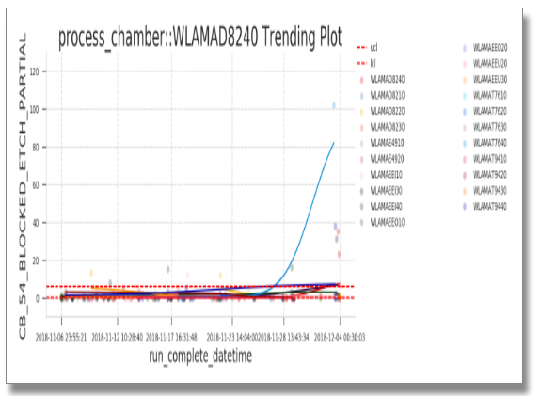
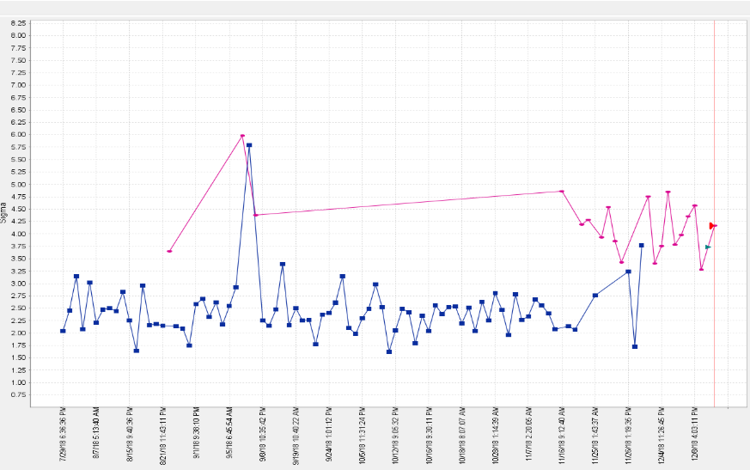
All the possible root causes
Step type filter
Single context filter
Obtain Root cause Slope
& Non root cause slope using scikit-learn
Slope value: + +
Slope value: + -
Slope difference>0.77
include
Slope difference<0.45
include
exclude
Slope difference>0.77
include
rt_ooc_ucl%>80% & nrt_ooc_ucl%<5%
rt_ooc_ucl%<15% & (max_nrt_ooc_value - ucl)/(ucl - lcl) >=15
Slope value: - -
rt_ooc_lcl%<15% & (lcl - min_nrt_ooc_value)/(ucl - lcl) >=15
Slope difference<0.45
exclude
rt_ooc_lcl%>80% & nrt_ooc_lcl%<5%
include
exclude
include
exclude

Slide 2
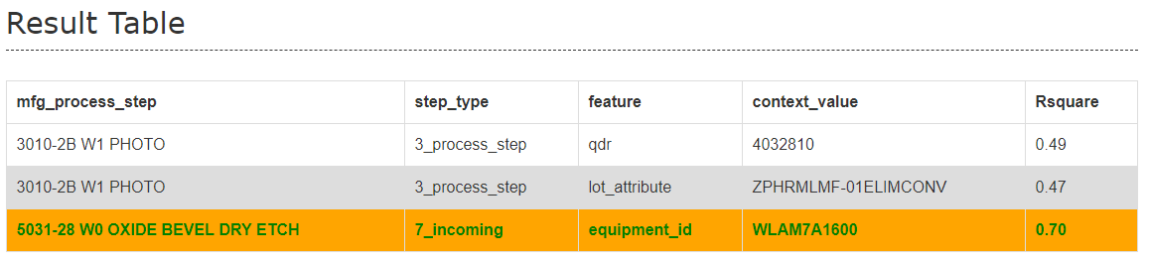
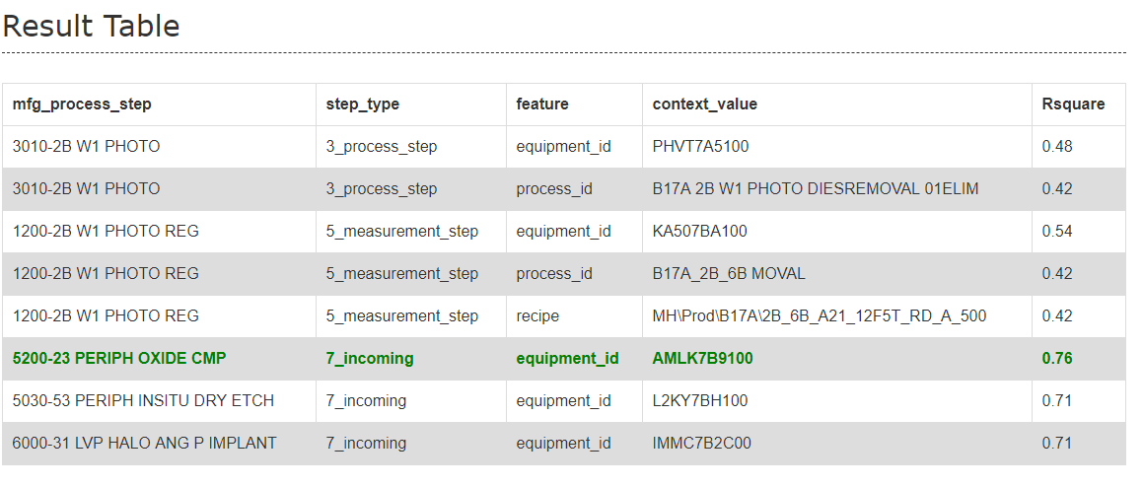
Previous: http://fslhdppds01/chronic_ad/ad_hoc/2018-11-23/7_261043_1_EWMA-Mean_2018112300.html
After: http://fslhdppds01/chronic_ad/2018-11-23/7_261043_1_EWMA-Mean_2018112300.html

